Slide 1
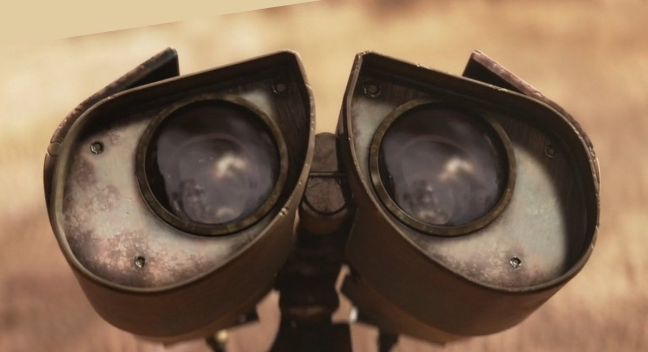
AI-ML
Adithya Venkateswaran

Slide 2
What is AI/Machine Learning?

Slide 3
This looks like the perfect example!! (No??)

Slide 4
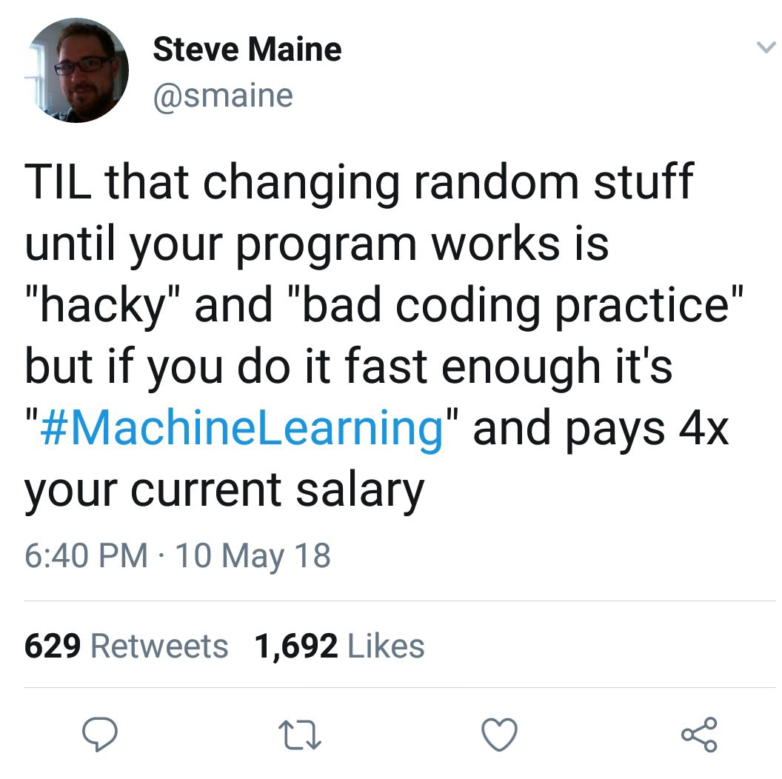
Maybe this?

Slide 5
What is the scope of AI?

Slide 6
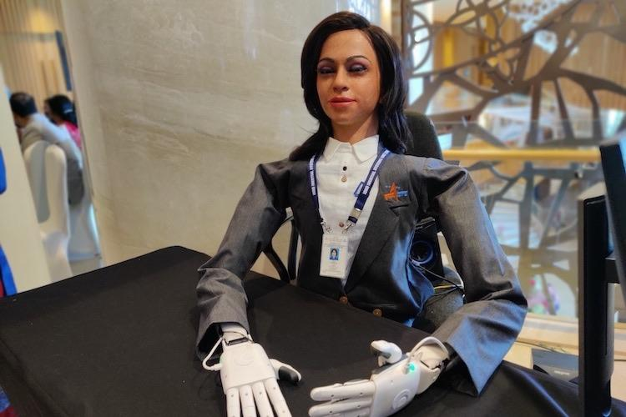
@ISRO -- Vyommitra

Slide 7
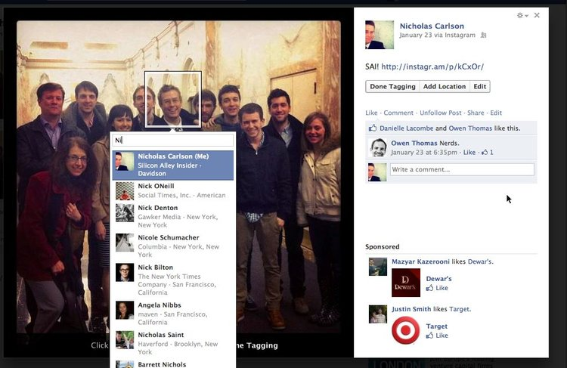
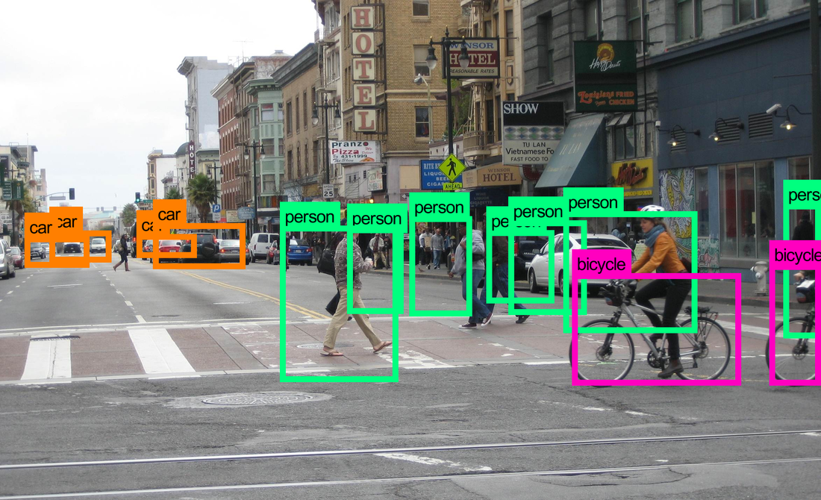

Expectations

Slide 8
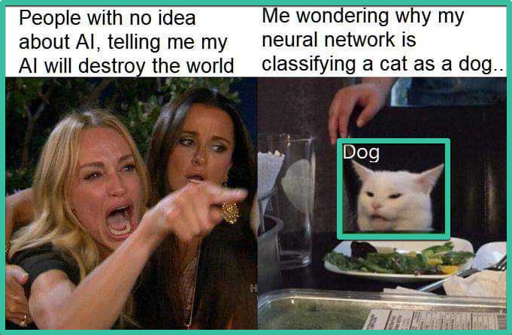
Reality

Slide 9
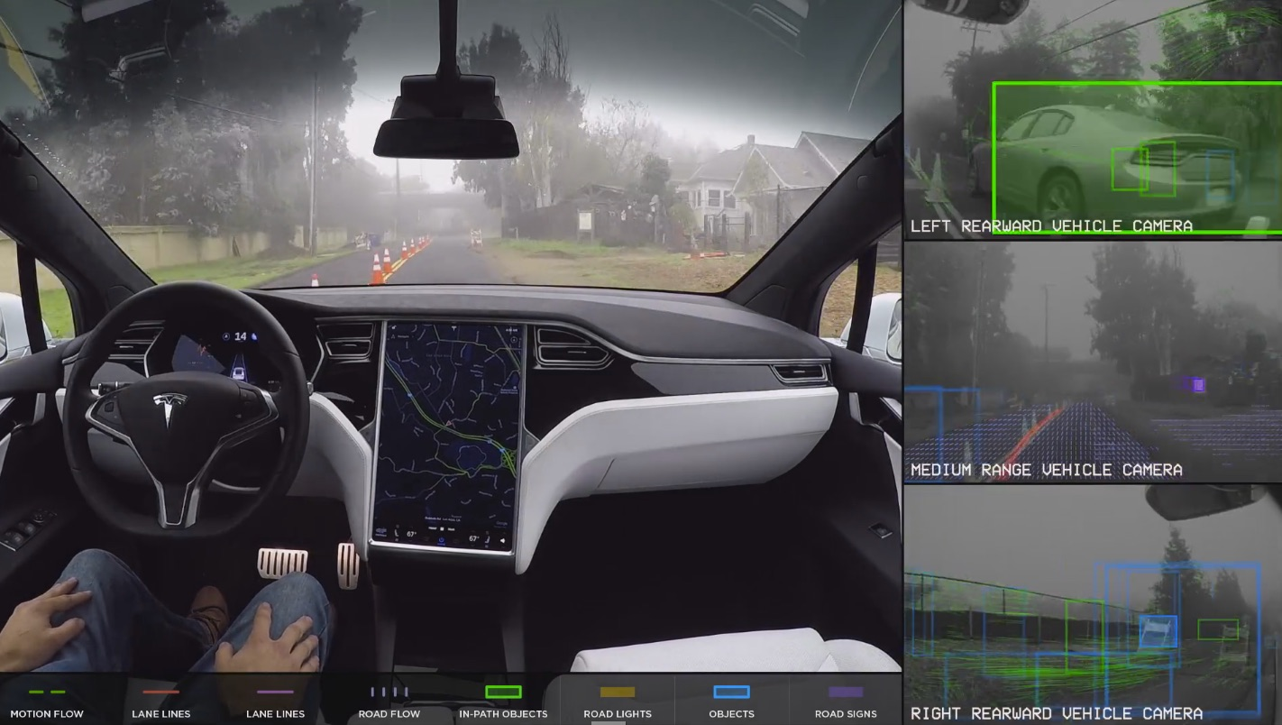

Slide 10
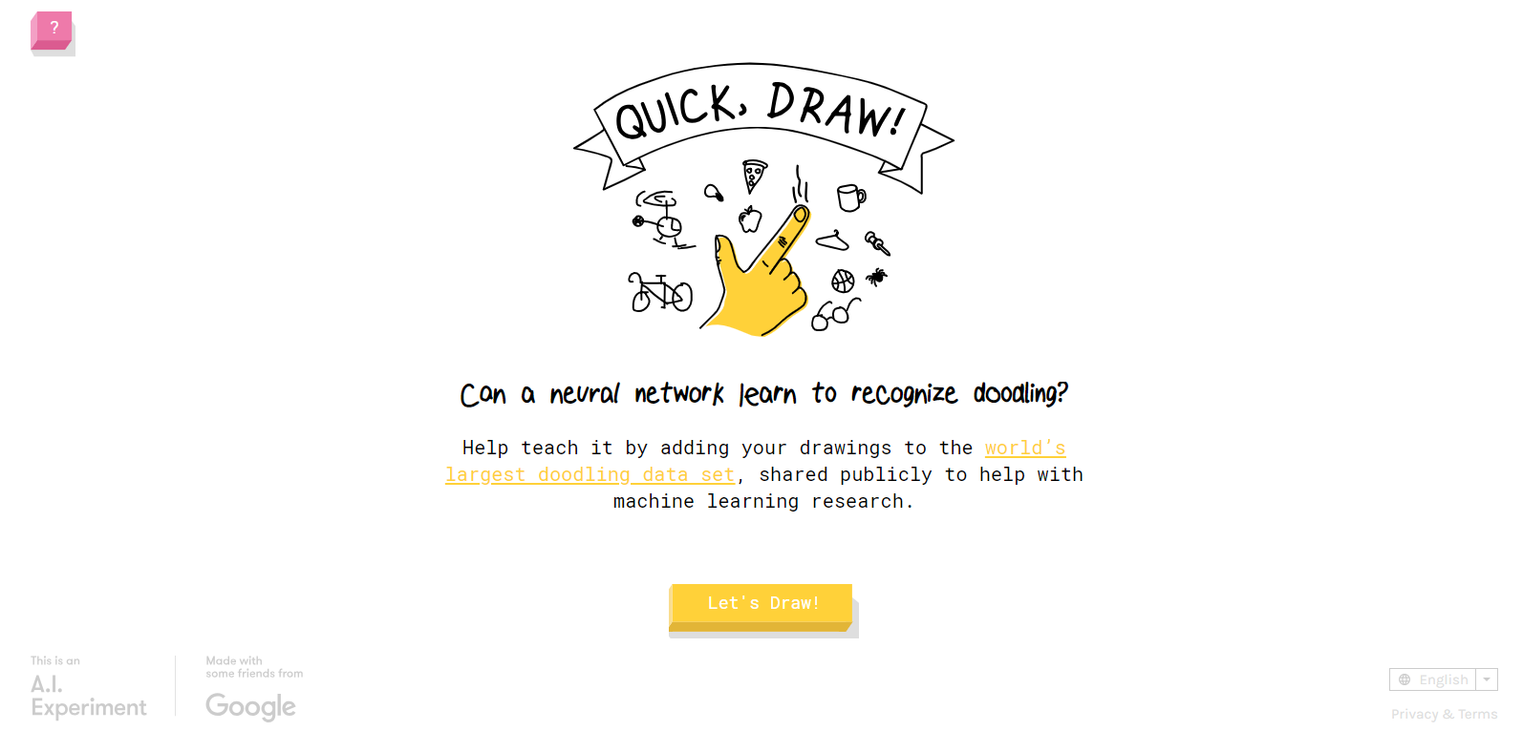
https://quickdraw.withgoogle.com/

Slide 11
How we did it!!
With love of course ;)

Slide 12





Slide 13
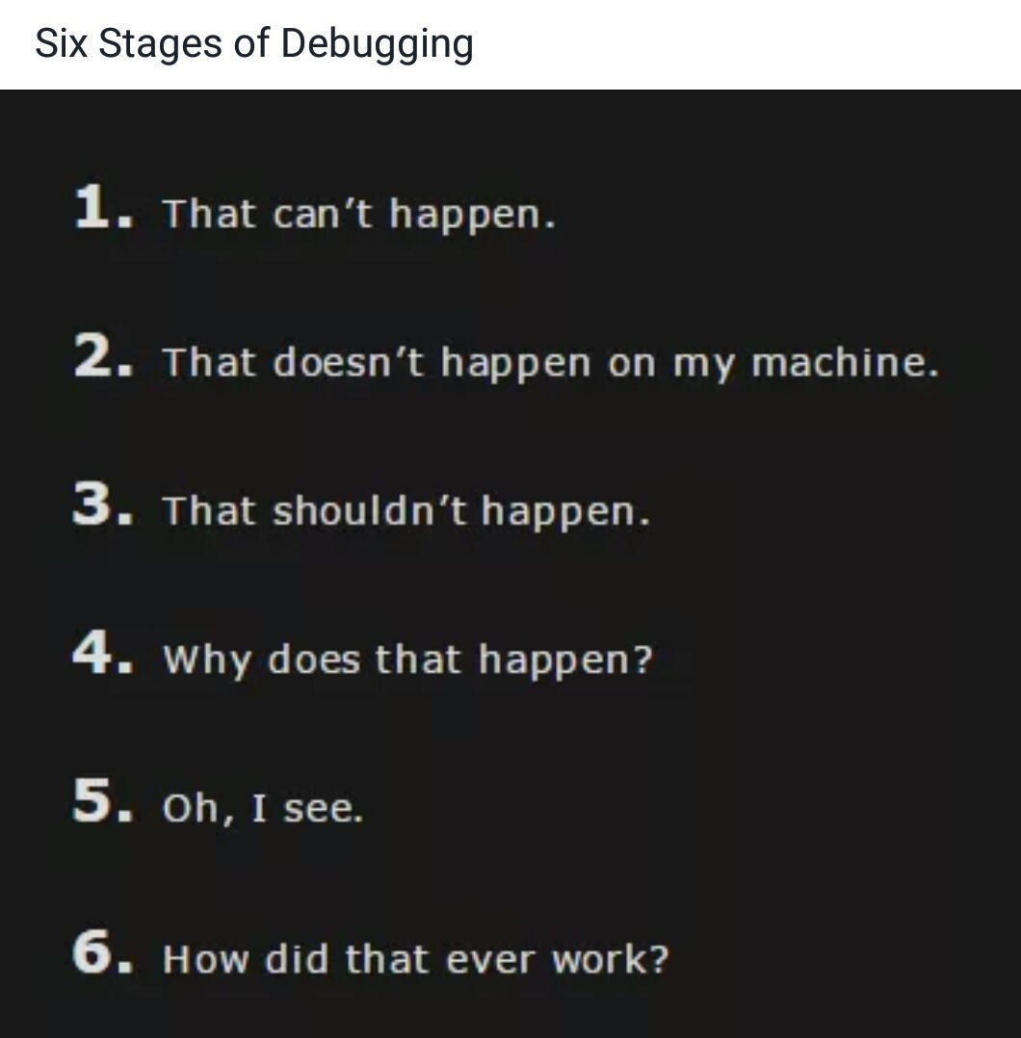
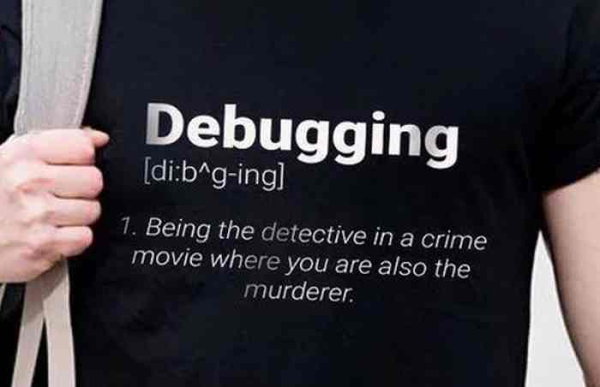
What we learnt..

Slide 14
Our Code

Slide 15
What we will do next!
Install Anaconda – learn to setup python environment (We will update you about the packages you need to install)
Read about Bayes theorem (You have studied it in 12th)
We will work on perceptron the session after
Slowly we will move into neural network and deep learning

Slide 16
Connect with us
Slack –
GitHub – AI-ML-Group-IIST (We will upload session documents and codes there)
Facebook – The CSE Group page

